Slide 1


Alcohols and phenols
第十章 醇与酚
Organic Chemistry A (1)
By Prof. Li Yan-Mei
Tsinghua University

Slide 2

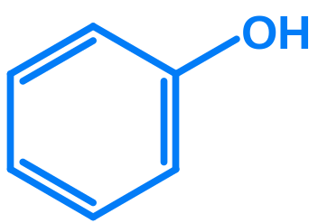
醇（Alcohol）
酚（Phenol）

Slide 3
Content
Part I Alcohols
10.1 Structure, isomerization, classification and nomenclature
10.2 Physical and spectroscopic properties
10.3 Monobasic/Monohydroxyl alcohol
10.4 Polybasic alcohol
10.5 Preparation of alcohol
10.6 Sources and usages

Slide 4
Part II Phenol/Hydroxybenzene
10.7 Structure and nomenclature
10.8 Physical and spectroscopic properties
10.9 Chemical reactions
10.10 Preparations
10.11 Sources and usages

Slide 5
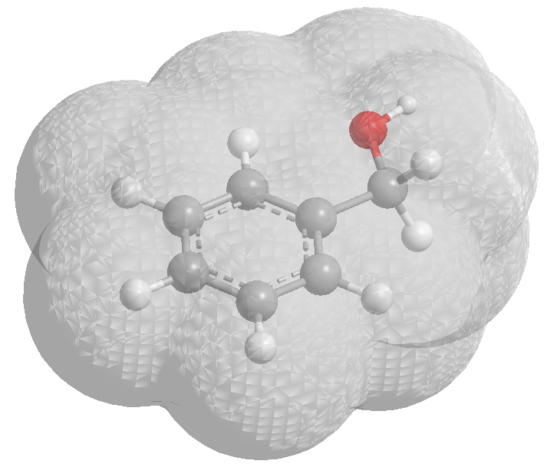
Part I
Alcohols
第一部分 醇

Slide 6
10.1 Structure, isomerization, classification and nomenclature
10.1.1 Structure
10.1.2 Isomerization
10.1.3 Classification
10.1.4 Nomenclature

Slide 7
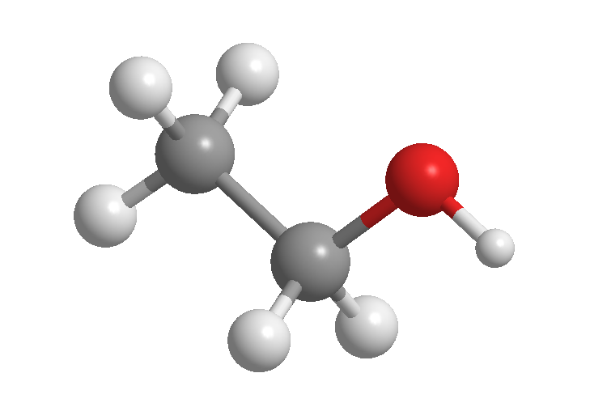
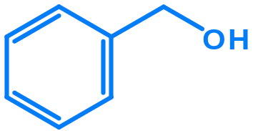
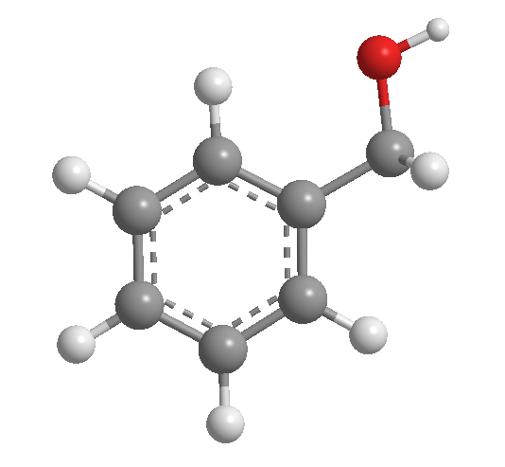
10.1.1 Structure 结构
sp³ hybridization
108.5º
μ ≈ 2D
Very close to water
Many alcohols completely miscible with water

Slide 8
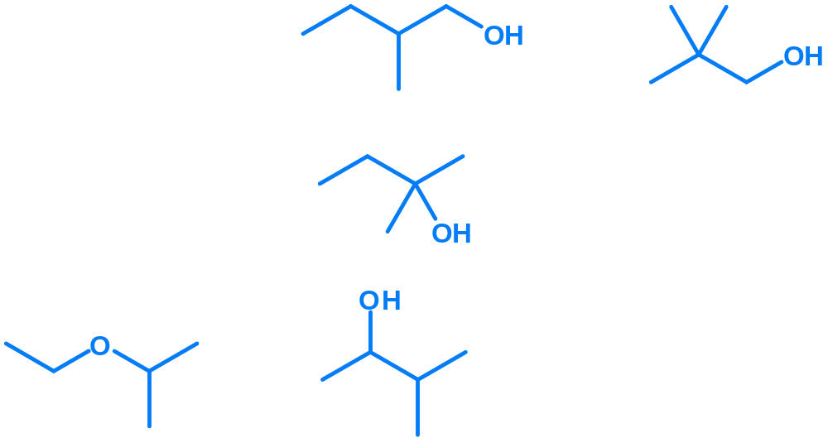
10.1.2 Isomerization 异构
Carbon chain isomerization
官能团异构
碳架异构
Fuctional group isomerization
Position isomerization
位置异构

Slide 9
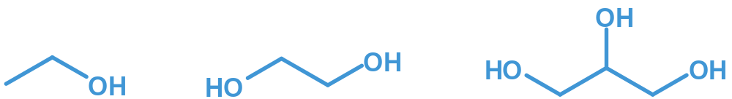
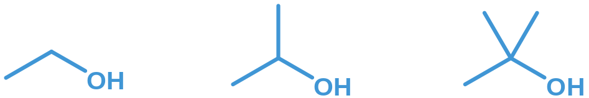
10.1.3 Classification 分类
根据羟基数目：
一元醇 二元醇 三元醇
根据所连的碳原子不同：
一级醇（伯醇） 二级醇（仲醇） 三级醇（叔醇）
根据所含碳原子数目：
< C₄
C₅ ~ C₁₁
> C₁₂
低级醇 中级醇 高级醇

Slide 10
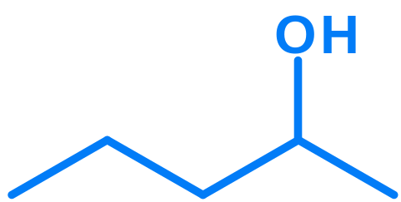
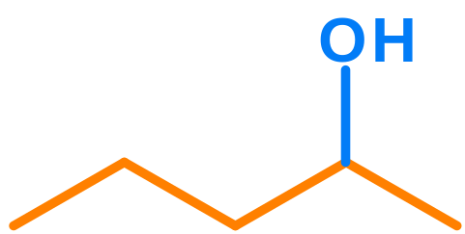





10.1.4 Nomenclature 命名
2-pentanol
5
3
1
4
2
1
Deciding the longest chain to which the hydroxyl group is attached
2
3
Decide the serial number for all carbon atoms.
Write down the name.

Slide 11
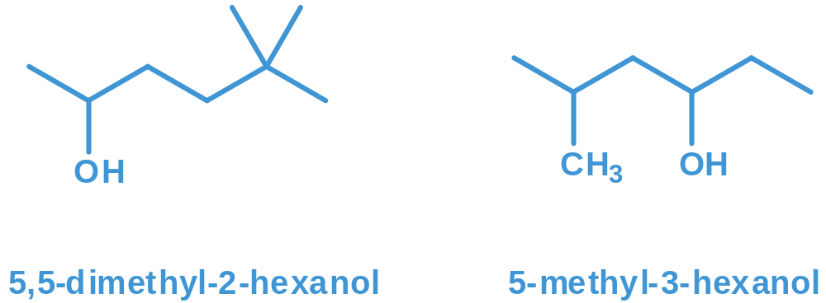
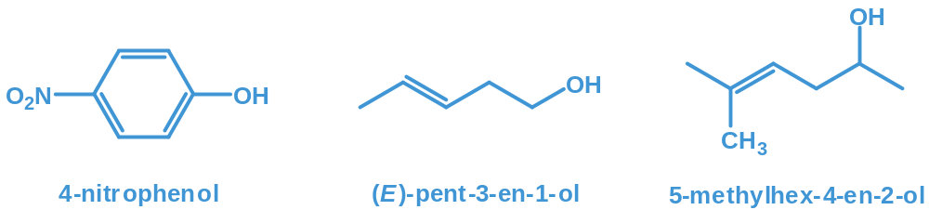

Slide 12
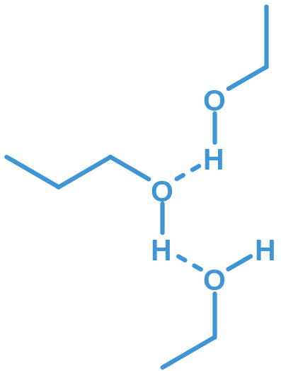
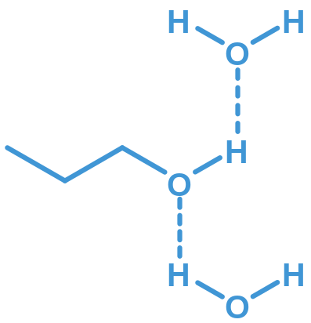
10.2 Physical and spectroscopic properties
10.2.1 Physical properties
Inter molecular hydrogen bond
Boiling point
Melting point
分子间氢键导致熔点、沸点较高
Simple alcohols completely miscible with water
与水形成氢键
低级醇一般与水任意混溶

Slide 13
Simple alcohols may form co-crystals with inorganic salts.
低级醇与一些无机盐（如：MgCl₂、CaCl₂、CuSO₄等）形成结晶状的分子化合物 － 结晶醇（醇化物）
MgCl₂, CuSO₄ ……
MgCl₂· 6 CH₃OH
CaCl₂· 4 C₂H₅OH
CaCl₂· 4 CH₃OH
用途：除去有机溶剂中少量的醇
将醇与其它有机物分开
危害：不可用MgCl₂、CaCl₂、CuSO₄等来干燥低级醇

Slide 14

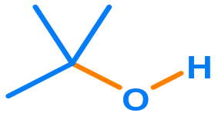
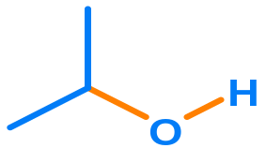
10.2.1 Spectrometry
IR
ν_{(O-H)}
ν_{(C-O)}
3640cm⁻¹
1050cm⁻¹
3630cm⁻¹
1100cm⁻¹
3620cm⁻¹
1150cm⁻¹

Slide 15
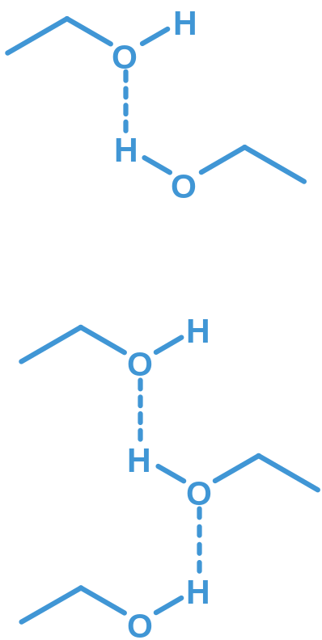
in inter molecular hydrogen bonding systems
ν_{(O-H)}
3550~3450cm⁻¹
ν_{(O-H)}
3400~3200cm⁻¹

Slide 16
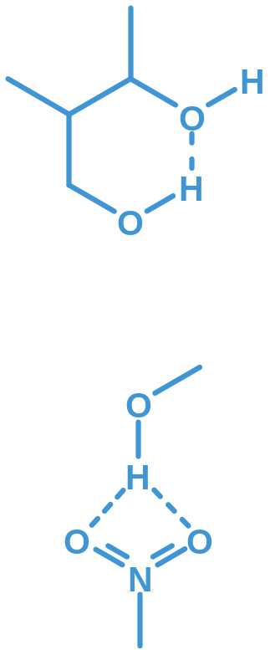
in intra molecular hydrogen bonding systems
ν_{(-OH)}
3600~3500cm⁻¹
ν_{(-OH)}
3200~3500cm⁻¹
ν_{(-OH)}
3400~3200cm⁻¹
multi molecule cluster

Slide 17
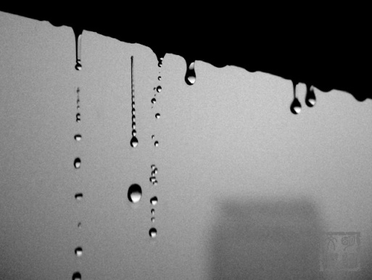
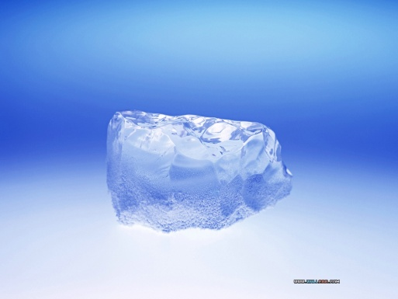
IR of OH bond in water molecule
ν_{(O-H)}
3710cm⁻¹
Liquid water
ν_{(O-H)}
3300cm⁻¹
Solid, ice
ν_{(O-H)}
3600~3450cm⁻¹
Crystallized water

Slide 18

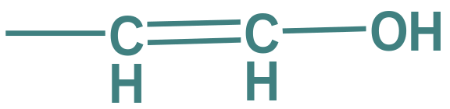
NMR
活泼氢
0.5 - 5.5
~ 3.7
15 - 19

Slide 19
10.3 Monobasic/Monohydroxyl alcohol
10.3.1 Acidity and basicity
10.3.2 Esterifying
10.3.3 Nucleophilic substitution
10.3.4 Dehydration and elimination

Slide 20
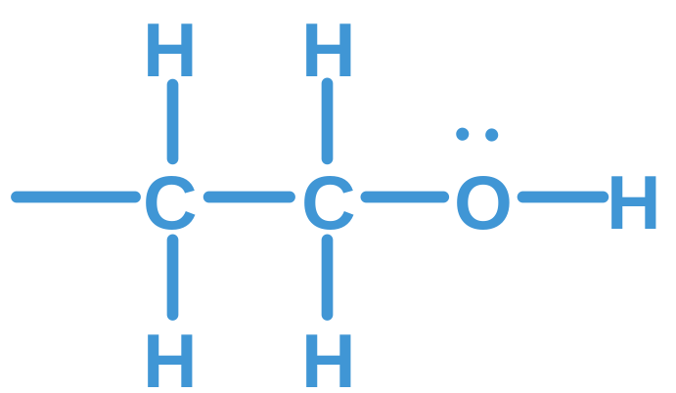
Brief introduction
Lone pair electrons
Basicity
Nucleophile
Acidity
Ionization
Reacting with
alkali metals
Labile beta-hydrogen
Elimination
Oxidation
Dehydration

Slide 21
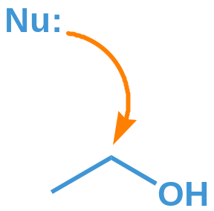
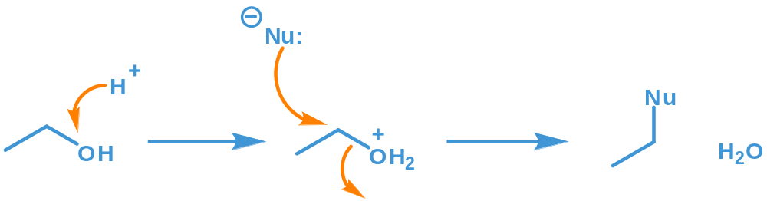
OH is not a good leaving group.
Proton is often required to change the bad leaving group OH into a good leaving group OH₂⁺
好的离去基团

Slide 22
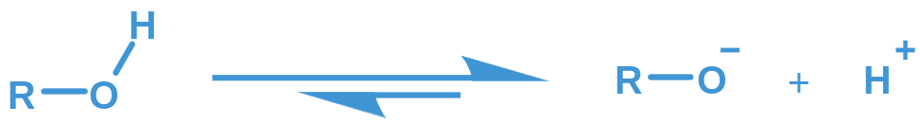
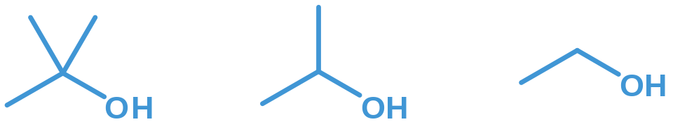
10.3.1 Acidity and basicity 酸、碱性
(A) Acidity 酸性
(1) Relative acidity 酸性顺序
Weaker
acidity
Stronger
acidity
原因：溶剂化效应的影响

Slide 23

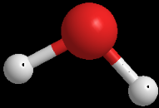
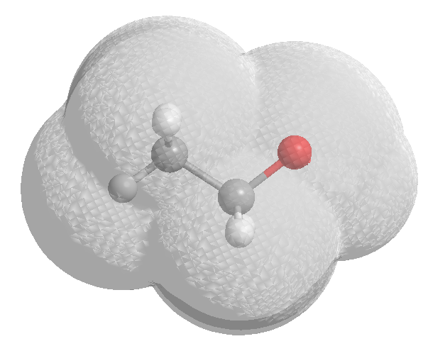
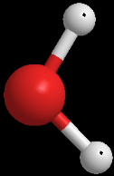
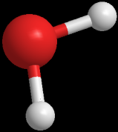
溶剂化效应的影响：
More solvation leads to more stable positive ion.

Slide 24
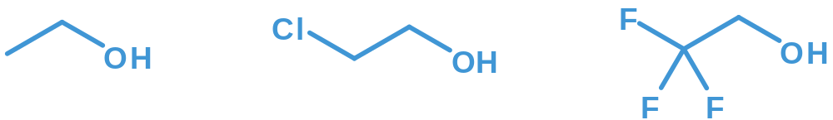
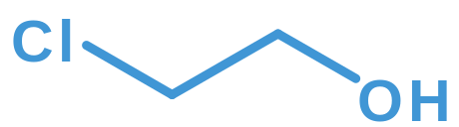
诱导效应的影响：
Weaker
acidity
Stronger
acidity
Electron cloud pulled
Inductive effect

Slide 25
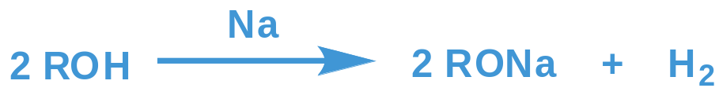
(2) Reaction with metals 与金属的反应
Na
Mg
Al
K
Ca
Reaction rate
RCH₂OH > R₂CHOH > R₃COH
Rb
Sr
Applications
Deal with such metals with alcohol, reducing reaction rate, avoiding explosion.
Alcoholic metals are good nucleophiles.
醇金属可作为好的亲核试剂。
Cs
Ba

Slide 26
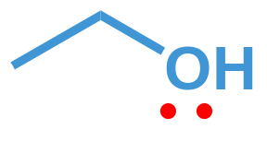
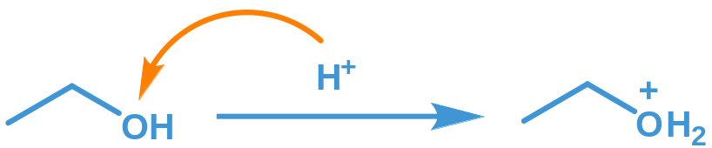
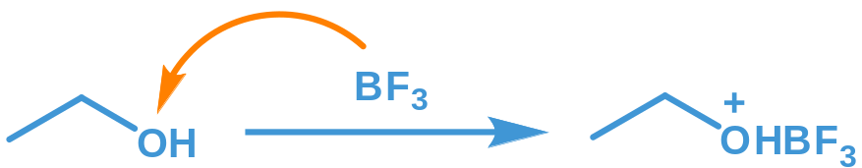
(B) Basicity 碱性
好的离去基团
Boron trifluoride
好的离去基团

Slide 27
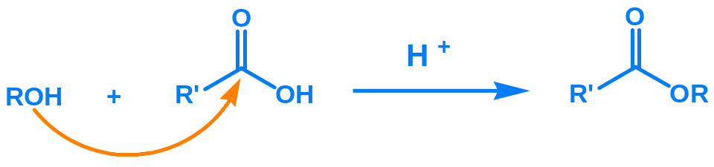
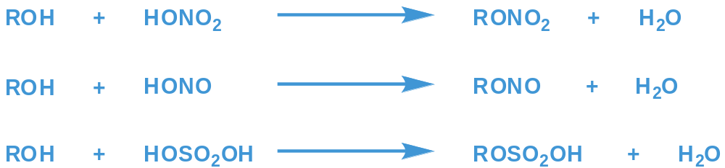
10.3.2 Esterification 酯化反应
Organic acid
某酸某酯
Inorganic acid
硝酸某酯
亚硝酸某酯
硫酸氢某酯

Slide 28
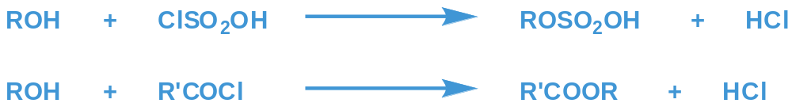
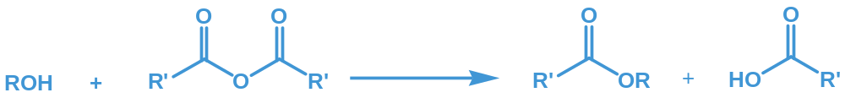
Acyl chloride
Anhydride

Slide 29
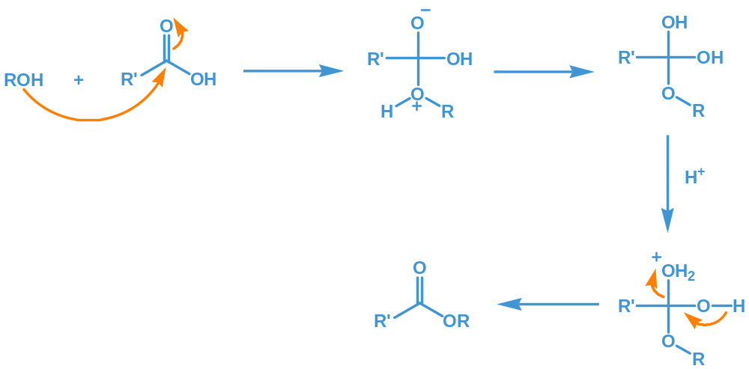
Mechanism 机理

Slide 30
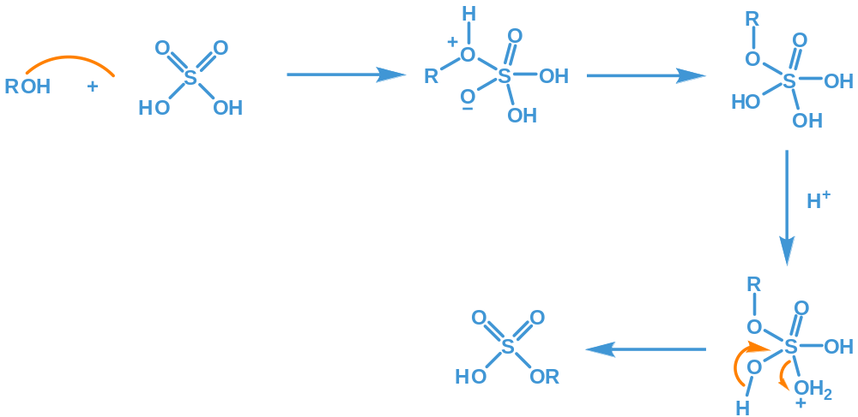

Slide 31
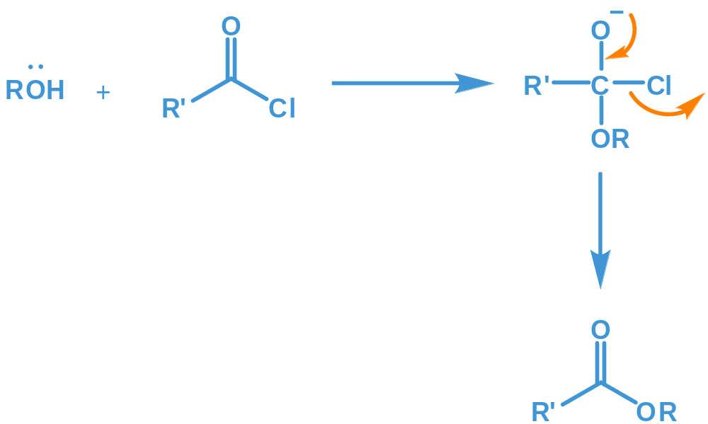

Slide 32
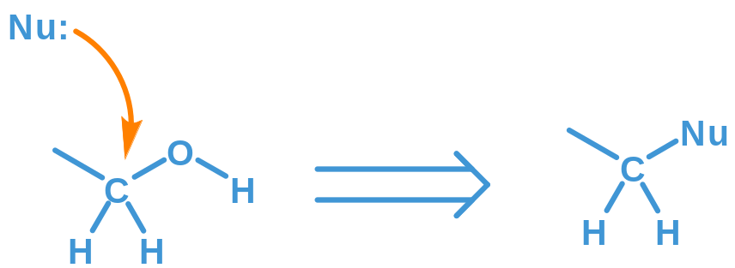
10.3.3 Nucleophilic substitution 亲核取代反应
Nucleophilic reagent 亲核试剂
HX, PX₃, SOCl₂ …...
常见产物：RX（RCl）

Slide 33
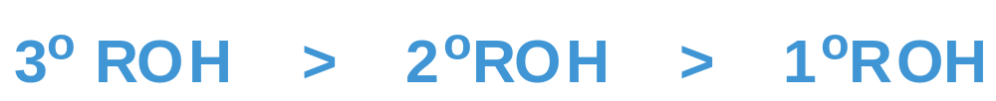
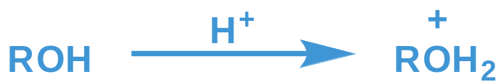
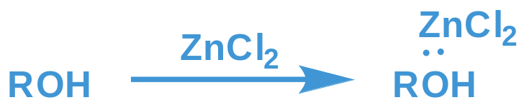
(A). Reactions with HX 与HX的反应
Reactivity
Mechanism：H⁺及ZnCl₂的作用 ---- 形成好的离去基团

Slide 34
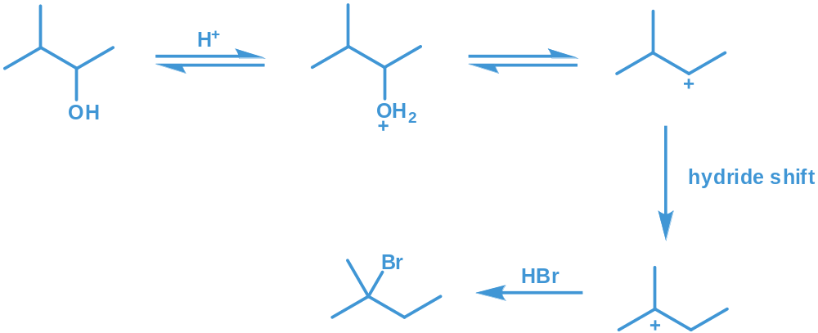
S_{N}1 or S_{N}2 ?
Generally, 1º ROH follows S_{N}2 mechanism, while 2º and 3º ROH follows S_{N}1 mechanism, which is often coupled with an anion rearrangement.

Slide 35
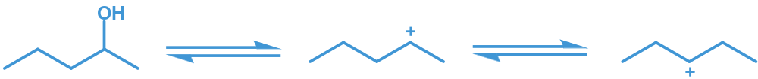
易发生重排

Slide 36
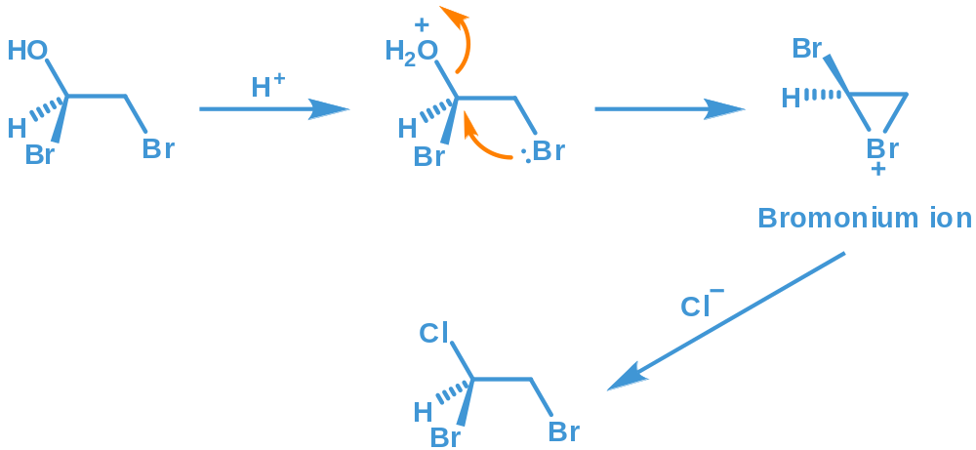
Mechanism----neighboring group participation 邻基参与

Slide 37

Lucas reagent: Lucas试剂
C6以下一元醇
溶于HCl
不溶于HCl
变浑
Reactivity 反应性
Reaction occurs immediately
立刻反应
Reaction occurs after 2~5 min
片刻(2-5分钟)后反应
Reaction occurs when heated
加热才反应
由于鉴别1⁰、2⁰、3⁰醇

Slide 38

(B). Reactions with PXn
不重排
Reaction
Mechanism
RCl is often prepared with PCl₅ and the corresponding alcohol, while RI with P, iodine, and the corresponding alcohol.

Slide 39

(C) Reactions with SOCl₂
不重排
No rearrangement!

Slide 40


10.3.4 Dehydration and elimination 脱水与消除
(A) Intermolecular 分子间脱水
Example
A side reaction of alcohol dehydration to form ethene.
You have performed this experiment at high school.

Slide 41

Mechanism
本质：亲核取代反应

Slide 42


(B) Intramolecular dehydration
Example
This reaction follows an E1 elimination mechanism.

Slide 43

Reactivity
Mechanism
Product
Follows Zaitzev’s rule
E form
本质：消去反应

Slide 44

注意：
Rearrangement occurs when a more stable anion is formed.
Competition between intermolecular and intramolecular reaction often exists. Under high temperature, elimination is favored, otherwise intramolecular dehydration.

Slide 45

10.3.5 Oxidation 氧化反应
一般地：
[O]: Na₂Cr₂O₇, HNO₃, KMnO₄

Slide 46


Slide 47



特殊情况：
实验室常用方法：
CrO₃ + pyridine
Sarrett reagent：
橙色透明
Jones reagent：
CrO₃ + diluted H₂SO₄
蓝绿色
不透明
鉴别！
pyridinium chlorochromate: 氯铬酸吡啶盐（PCC）

Slide 48


工业上常用方法：脱氢
还原性气氛，易将产物又还原为醇
When air is pumped in, water vapor is generated.

Slide 49
10.4 Polybasic alcohol 多元醇
10.4.1 Reactions similar to monobasic alcohol
10.4.2 Reactions different from monobasic alcohol

Slide 50

10.4.1 Reactions similar to monobasic alcohol
与一元醇类似的性质
Acid-base reaction
Esterifying
Nucleophilic substitution
Dehydration and elimination
Hydrogenation (Oxidation)
Dehydrogenation

Slide 51

10.4.2 Reactions different from monobasic alcohol 多元醇的特殊性质
(A). Reaction with Cu(OH)₂
Soluble, blue
蓝色 可溶
Identification of 1,2-diol, or some substance with similar substructure.
用于鉴别1,2-二醇或具有邻二羟基的多元醇

Slide 52

(B). Reaction with periodic acid 与高碘酸的反应
Reaction
This reaction is usually used to identify structures.

Slide 53

Mechanism
环状酯中间体
氧化值：＋7
氧化值：＋5

Slide 54


注意：环状酯中间体，要求两个羟基处于顺式
均难发生反应

Slide 55

Application
反应定量进行，由消耗的高碘酸的量可测定邻二醇的量
推断结构：

Slide 56


(C). Pinacol rearrangement 嚬哪醇重排
邻二醇在酸作用下的重排
Pinacol
嚬哪醇
Pinacolone
嚬哪酮
较不稳定的碳正离子（碳外层6个电子）
甲基迁移
较稳定的 盐（碳外层8个电子）
钅
羊

Slide 57

主产物
次产物
Which carbocation is favored ? 生成哪个碳正离子？

Slide 58

甲基迁移
苯基迁移
迁移能力：
R-ph > ph > NO₂-ph > R
> CH₃ > H
即：提供电子、稳定正电荷能
力较强的基团优先迁移
Which group shifts ? 哪个基团迁移？

Slide 59

迁移基团与离去基团处于反式位置时较易迁移
Shifting group and leaving group 迁移的立体化学要求

Slide 60



(D). Polymerization and cyclization 聚合与成环
聚乙二醇

Slide 61
10.5 Preparation of alcohol
(learn on your own)
10.6 Sources and usages
(learn on your own)

Slide 62

Part II
Phenols
第一部分 酚

Slide 63


10.7 Structure and nomenclature 结构和命名
Phenol
酚
Alcohol
醇

Slide 64

μ = 1.6 D
强给电子基团
Electron-donating conjugation
Nomenclature 命名
采用芳烃命名原则。

Slide 65

10.8 Physical and spectroscopic properties
10.8.1 Physical properties
苯酚在冷水中微溶，加热时可无限溶解
分子间氢键
纯的酚无色，但易被空气中的氧气氧化而呈略红或褐色
毒性

Slide 66


10.8.1 spectroscopic data
IR
ν_{(O-H)}
ν_{(C-O)}
3610cm⁻¹
1200cm⁻¹
NMR
4 - 12 ppm

Slide 67

Mass spectrometry

Slide 68


Slide 69
10.9 Chemical reactions
10.9.1 Electrophilic reactions
10.9.2 Other properties

Slide 70

10.9.1 Electrophilic reactions
邻对位活化基
反应条件温和
反应速度快
产物邻、对位为主
容易发生多取代

Slide 71


白色
极灵敏（10ppm即可显色）
可用于鉴别苯酚
控制条件才可获得一卤代产物

Slide 72
10.9.2 Other properties 苯酚的特殊反应
(A). Acidity 酸性
H₂CO₃
H₂O
C₂H₅OH
C₂H₂
NH₃
10
15.74
15.9
~25
34
若芳香基团上有吸电子基团，则酚酸性增强。

Slide 73

亲核试剂
可用于制备醚
可用于制备苯甲醚

Slide 74
(B). Reaction with FeCl₃ 与FeCl₃的反应
紫色
适用：苯酚，萘酚及其衍生物
用途：鉴别苯酚
（鉴别具有烯醇结构的化合物）
颜色：蓝色，紫色为主
烯醇结构

Slide 75

(C). Oxidation
对苯醌
对位取代基可能脱去
注意：1、因所用氧化剂通常都有颜色，反应前后颜色变化不明显，故一般不用于鉴别
2、磺化、硝化等反应时应注意反应条件，以免被氧化

Slide 76
10.10 Preparations
10.10.1 Preparations of phenol
苯酚的制备
10.10.2 Preparations of naphthol
萘酚的制备

Slide 77

10.10.1 Preparations of phenol 苯酚的制备
(A). Alkali Fusion of Sodium Benzene-sulfonate 苯磺酸碱融法
融熔

Slide 78


(B). Hydrolysis of Benzyl Chloride 氯苯水解
氯苯的制备：

Slide 79

(C). Cumene Oxidation 异丙苯氧化
两种化工原料
两种石化产品

Slide 80

10.10.2 Preparations of naphthol 萘酚的制备
(A). Alkali Fusion 碱融法
融熔
融熔

Slide 81

(B). Hydrolysis of α-naphthalidine α-萘胺水解
10.11 Sources and usages
(Learn on your own)

Slide 82


